Slide 1
SAENIS EFFI-CYCLE
CAE Presentation
Team_ID:20055
Team_Name: Team Samanvaya Racing

Slide 2
Content
Vehicle Design
Impact Load Calculation
FE Modelling and CAE Analysis of Frame
FE Modelling and CAE Analysis of Hard-Points
Result Comparison and Optimization Details

Slide 3
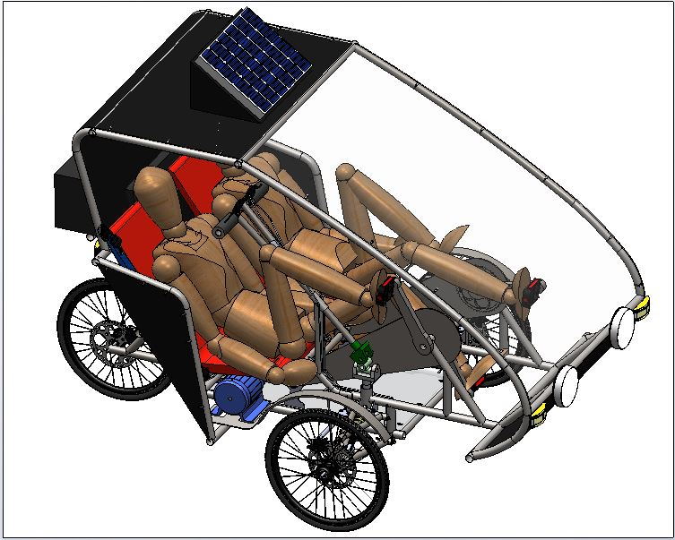
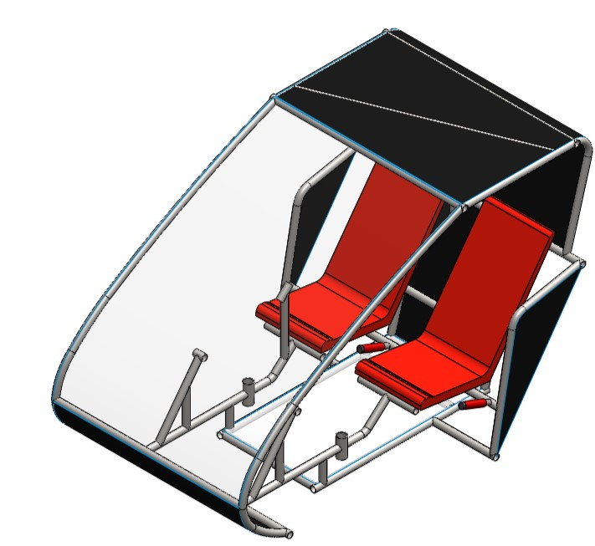
Vehicle Design
Isometric View
Page 1.1

Slide 4
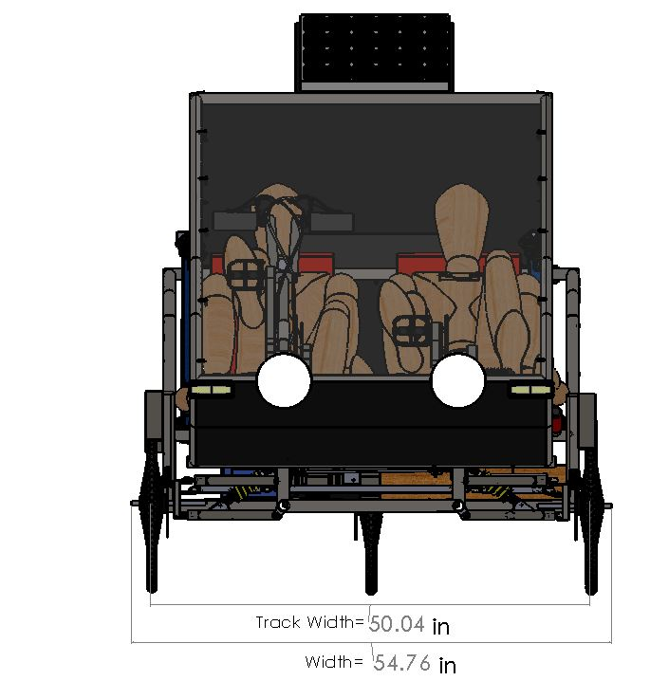
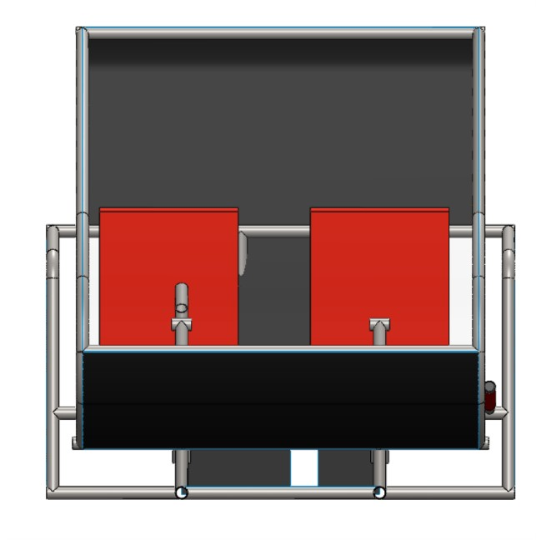
Vehicle Design
Front View
Page 1.2

Slide 5
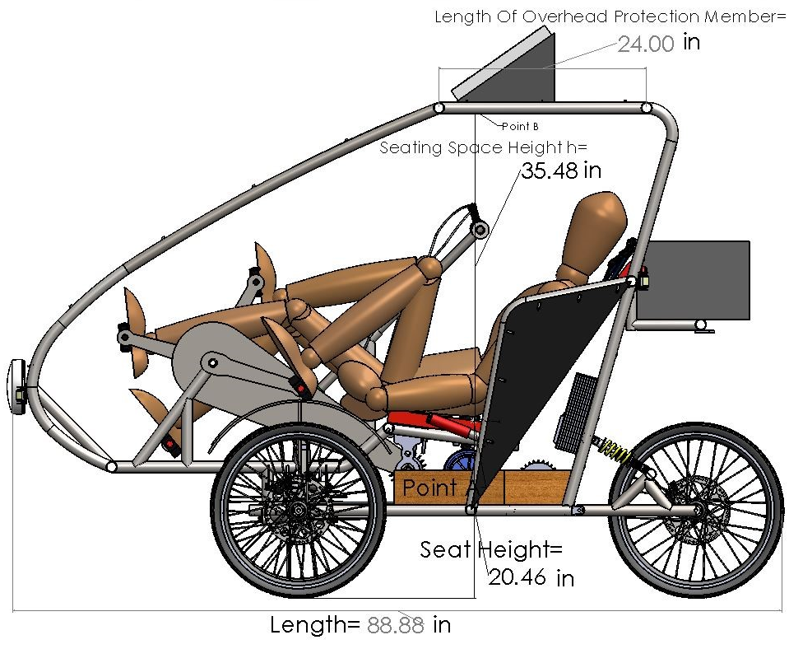
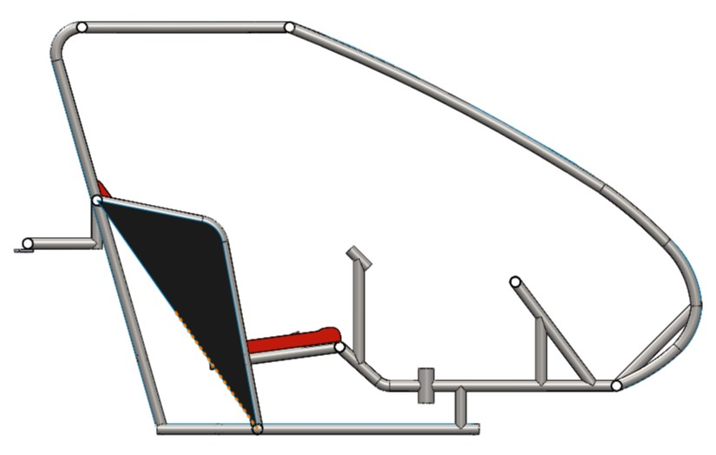
Vehicle Design
Side View
Page 1.3

Slide 6
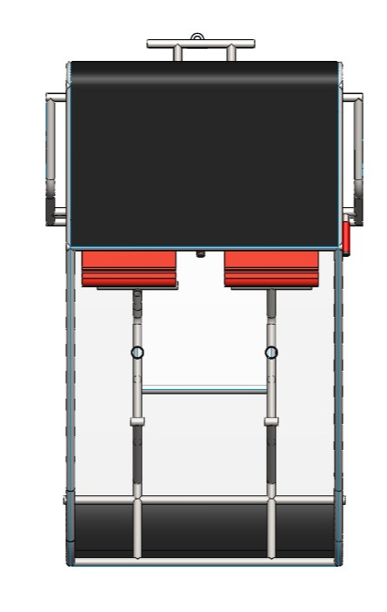
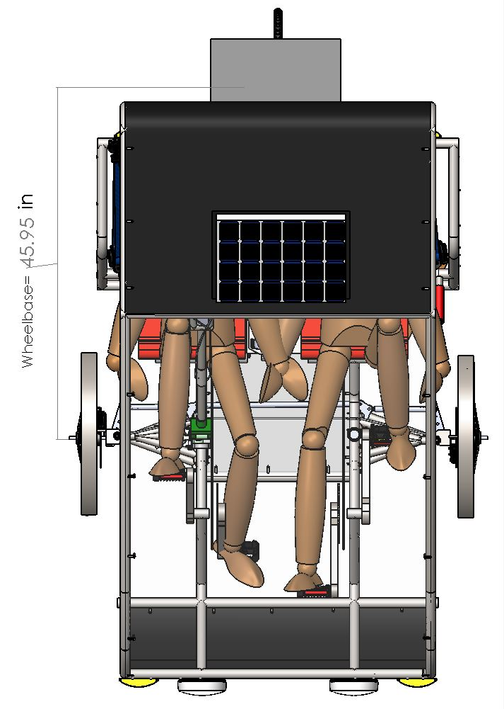
Vehicle Design
Top View
Page 1.4

Slide 7
Impact Load Calculation
Front Impact
Assumption & Considerations:
Following assumptions & consideration were made for performing the analysis for frontal impact on frame/vehicle.
Impact force was applied on the foremost part of the roll cage.
Mounting points of suspension arms were fixed.
Initial Speed=9.11m/s
Final Speed=0m/s
Reaction time=0.13s
Calculation of Impact Forces:
Work Done= (0.5*M*Vfinal2 - 0.5*M*Vinitial2)
|W|=|-0.5*M*Vinitial2|
=|-0.5*245*9.112|
=10166.5 Nm
Work Done=Force * Displacement
=(F*S)
S=Impact Time*Vmax
=0.13*9.114
=1.184m
So,
F=W/S
=10166.5/1.184
=8586.5 N
≈8600 N
Page 2.1

Slide 8
Side Impact
Assumption& Considerations:
Following assumptions & consideration were made for performing the analysis for frontal impact on frame/vehicle.
Impact force was applied on the foremost part of the roll cage.
Mounting points of suspension arms were fixed.
Initial Speed=9.114m/s
Final Speed=0m/s
Reaction time=0.30s
Calculation of Impact Forces:
Work Done= (0.5*M*Vfinal2 - 0.5*M*Vinitial2)
|W|=|-0.5*M*Vinitial2|
=|-0.5*245*9.1142|
=10166.5 Nm
Work Done=Force*Displacement
=(F*S)
S=Impact Time*Vmax
=0.30*9.114
=2.73m
So,
F=W/S
=10166.5 /2.73
=3723.9 N
≈3800 N
Page 2.2

Slide 9
Roll Over
Assumption & Considerations:
Following assumptions & consideration were made for
Lower most members were fixed while performing the analysis for rollover on frame/vehicle.
Mounting points of suspension arms were fixed.
Impact force = G
Reaction Time=0.13 sec
Calculation of Impact Forces:
M * g * h =0.5 * M * v2
v=√2 * 9.81 * 2
=6.2641m/s
(Now from work energy principal)
Work Done=Change in Kinetic Energy
|W|=|-0.5*M*vinitial2|
=|0.5*245*6.26412|
=4806.7 N
S=Impact time * v(max)
=0.13*6.2641
=0.814333m
F=W/S
=4806.7/0.81433
=5902.7 N
≈6000 N
Page 2.3

Slide 10
Bending Analysis
Assumption & Considerations:
Following assumptions & consideration were made for
Lower most members were fixed
performing the analysis for bending on frame/vehicle.
Mounting points of rear suspension arms were fixed and force on mounting points of front suspension arms was applied.
Vehicle undergoes a bump of size 10in=0.254m
Calculation of Forces:
0.7 * k * x2 = 0.5 * m * v2
m * g * h = 0.5 * m * v2
v=2.23m/s
(Now by work principle work done by Spring is equal to change in kinetic energy)
(Here k is spring constant and its value is 7883.8 N/m)
7883.8 * x2 = 240 * 2.232
x = 0.151 m
Force applied by the spring on the frame is
k * x=1190.45 N
≈1200 N
Page 2.4

Slide 11
Torsional Analysis
Assumption & Considerations:
Following assumptions & consideration were made for
Lower most members were fixed
performing the analysis for bending on frame/vehicle.
Mounting points of rear suspension arms were fixed and force on mounting points of front suspension arms was applied.
Vehicle undergoes a bump of size 10in=0.254m
Calculation of Forces:
0.7 * k * x2 = 0.5 * m * v2
m * g * h = 0.5 * m * v2
v=2.23m/s
(Now by work principle work done by Spring is equal to change in kinetic energy)
(Here k is spring constant and its value is 7883.8 N/m)
7883.8 * x2 = 240 * 2.232
x = 0.151 m
Force applied by the spring on the frame is
k * x=1190.45 N
≈1200 N
Page 2.5

Slide 12
Suspension Mounting Points
Assumption & Considerations:
Following assumptions & consideration were made.
Frame was fixed for the analysis of suspension mounting points
Calculation of Forces:
Max bump size=3.5in=8.89cm
v=√(2gh)=1.32 m/s
collision time=.54 s
Conservation of momentum
mv=-mv’
v’=-v
Change in momentum mv-(-mv)
F(bump force)=2mv/.54=2*245*1.32/.54
= 1197.77 N
≈1500N
Page 2.6

Slide 13
Seat Mounting Points
Assumption & Considerations:
Following assumptions & consideration were made.
Suspension Mounting Points were fixed and weight of each driver was taken as 75 Kg.
Acceleration due to gravity=9.8m/s2
Calculation of Forces:
Force= Mass x Acceleration
Force= 75*9.8
Force=735N
≈750N
Page 2.7

Slide 14
Battery Mounting Points
Assumption & Considerations:
Following assumptions & consideration were made.
Suspension Mounting Points were fixed and weight of battery is 12 Kg.
Acceleration due to gravity=9.8m/s2
Calculation of Forces:
Force= Mass x Acceleration
Force= 12*9.8
Force=117.6N
≈150N
Page 2.8

Slide 15
Solar Panel Mounting Points
Assumption & Considerations:
Following assumptions & consideration were made.
Suspension Mounting Points were fixed and weight of solar panel is 3 Kg.
Acceleration due to gravity=9.8m/s2
Calculation of Forces:
Force= Mass x Acceleration
Force= 3*9.8
Force=29.4N
≈50N
Page 2.9

Slide 16
FE modelling and CAE Analysis of Frame
Include image of FE models for iteration-1.
Include FE model of different load cases (front, side, rollover etc) in separate slides.
For each load cases following pictures to be included:
Pre-processing: Meshed View, Load Distribution, Boundary Conditions
Post-processing: view after simulation showing stress, strain, deformation and FOS.
Page 3.1

Slide 17
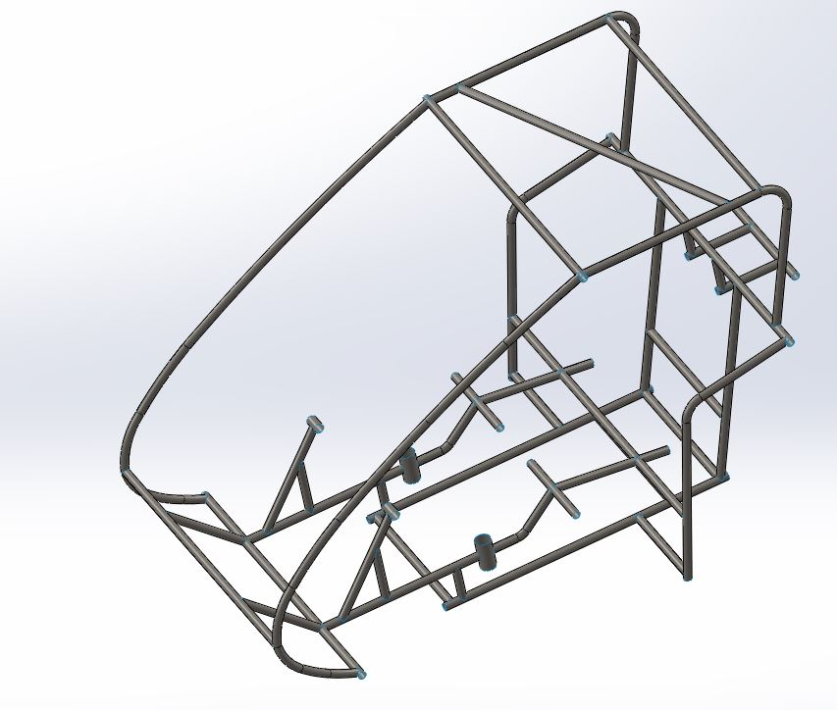
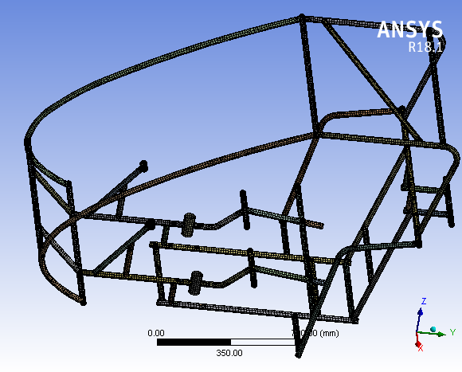
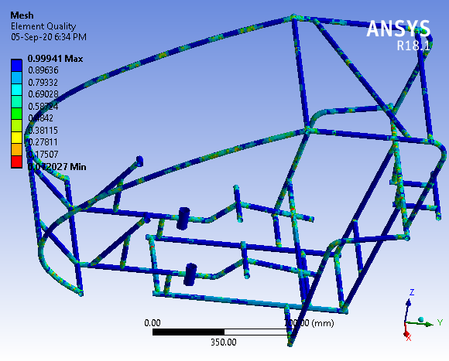
Steel AISI 1018,1in x 0.84in x 2mm
Page 3.2

Slide 18
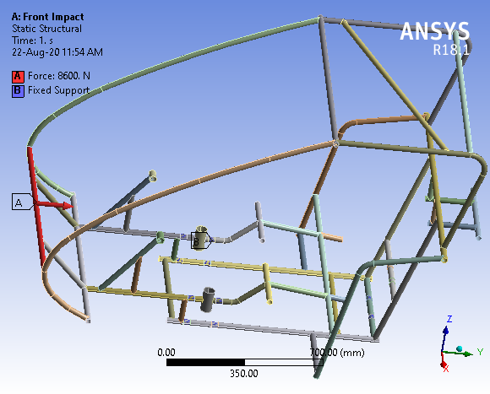
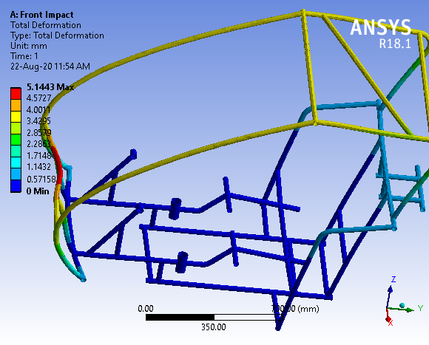
FRONT IMPACT
Page 3.3

Slide 19
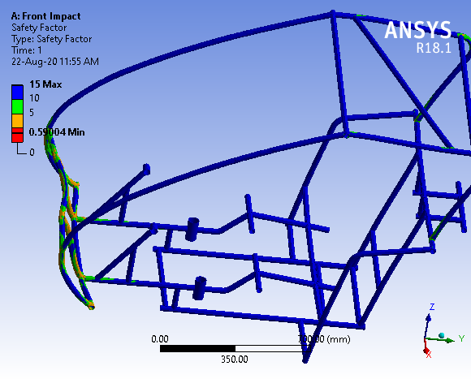
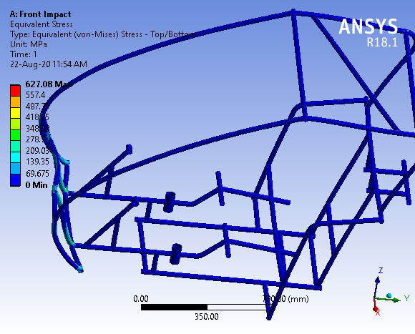
FRONT IMPACT
Page 3.4

Slide 20
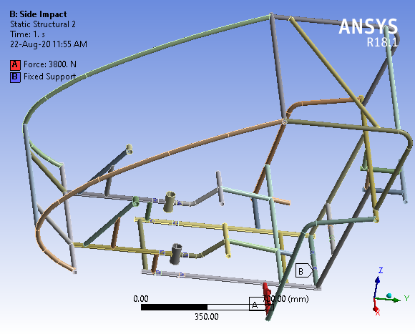
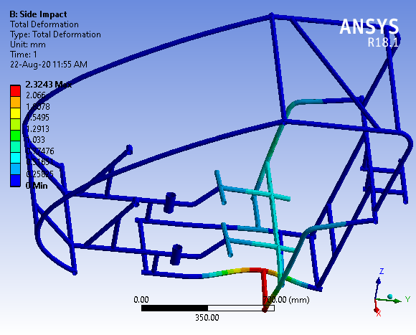
SIDE IMPACT
Page 3.5

Slide 21
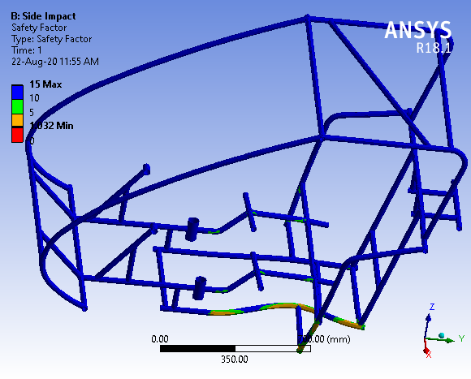
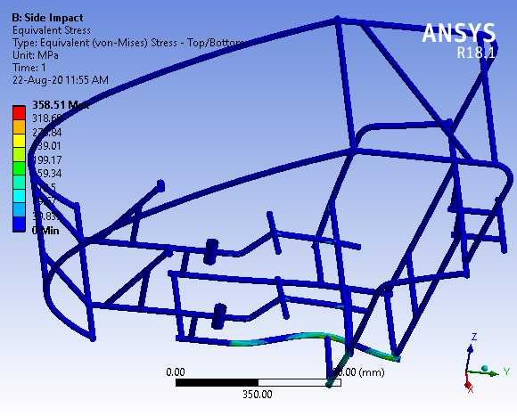
SIDE IMPACT
Page 3.6

Slide 22
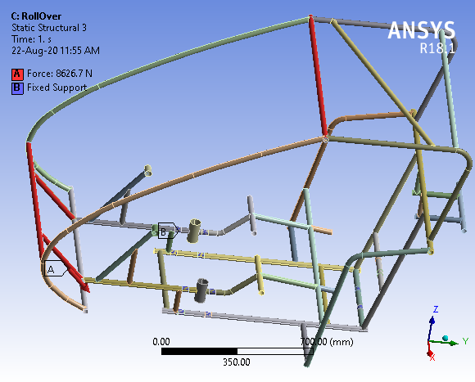
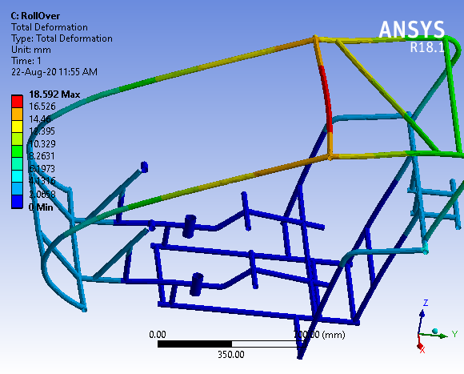
ROLL-OVER IMPACT
Page 3.7

Slide 23
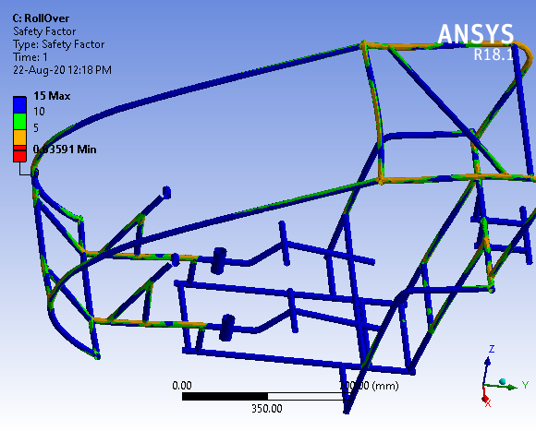
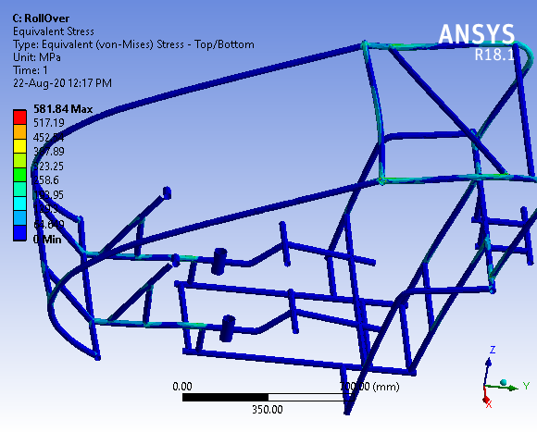
ROLL-OVER IMPACT
Page 3.8

Slide 24
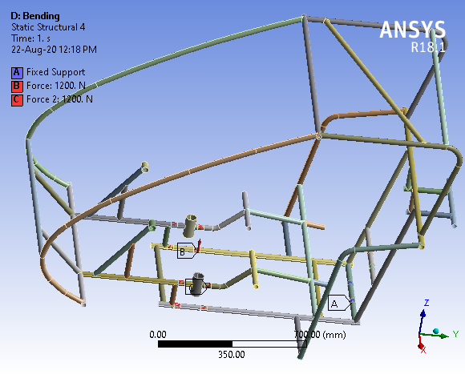
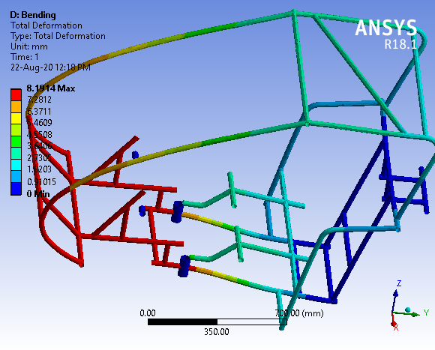
BENDING
Page 3.9

Slide 25
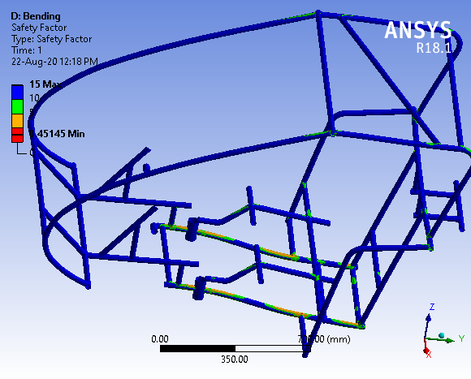
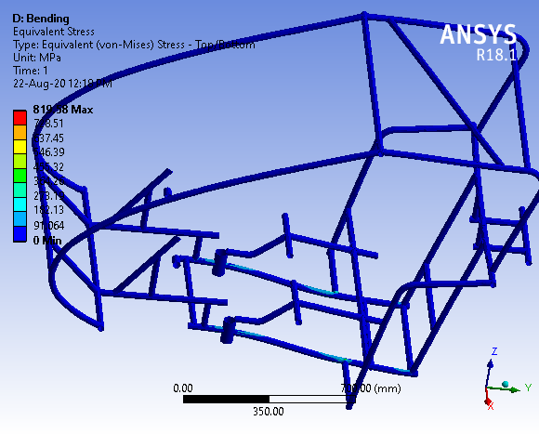
BENDING
Page 3.10

Slide 26

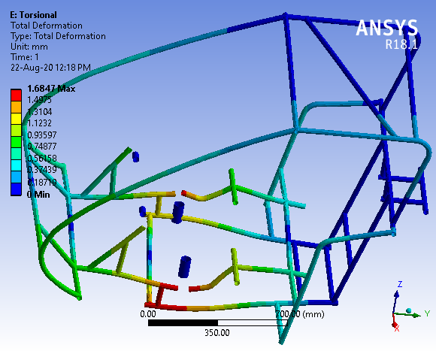
TORSION
Page 3.11

Slide 27
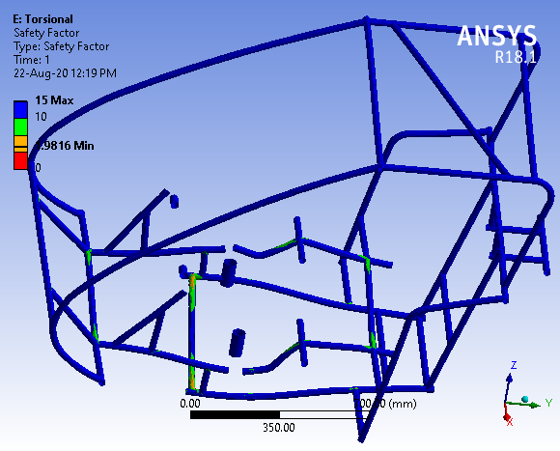
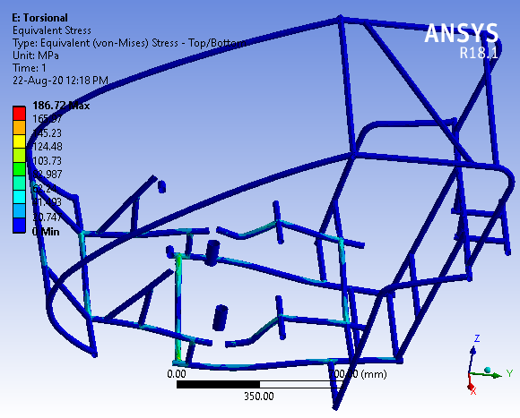
TORSION
Page 3.12

Slide 28
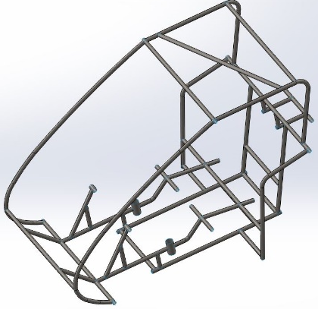
FE modelling and CAE Analysis of Frame
Parameters considered/Change details : 0.15-0.20% Carbon,1in Diameter and 2mm thickness, AISI 1018
(Instructions : Material spec ,cross section, Material Combinations)
Target Weight- 30Kg
Design weight- 32.57Kg
Iteration-1
Test Run | Max Stress (MPa) |  | Max Deformation (mm) |  | Min FOS |  | Acceptability
 | Actual | Target | Actual | Target | Actual | Target | Yes/No
Frontal | 627.08 | 400 | 5.14 | 3 | 0.59 | 1 | No
Side | 358.51 | 200 | 2.32 | 1 | 1.03 | 2 | Yes
Rollover | 581.84 | 400 | 18.59 | 10 | 0.63 | 1 | No
Torsion | 186.72 | 200 | 1.68 | 2 | 1.98 | 3 | Yes
Bending | 819.58 | 400 | 8.19 | 3 | 0.45 | 1 | No
Justification of Accepting/ Rejecting Design: It is rejected because the rulebook instructed to have a minimum 1.5mm thickness and further the min factor of safety is very less thus is risky for the driver.
Page 3.13

Slide 29
FE modelling and CAE Analysis of Frame
Include image of FE models for iteration-2.
Include FE model of different load cases (front, side, rollover etc) in separate slides.
For each load cases following pictures to be included:
Pre-processing: Meshed View, Load Distribution, Boundary Conditions
Post-processing: view after simulation showing stress, strain, deformation and FOS.
Page 3.14

Slide 30
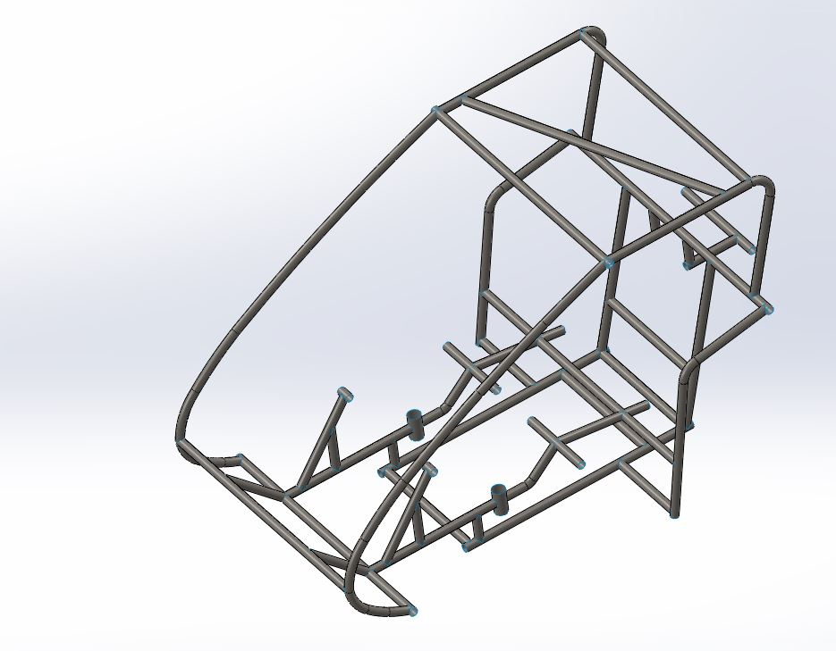
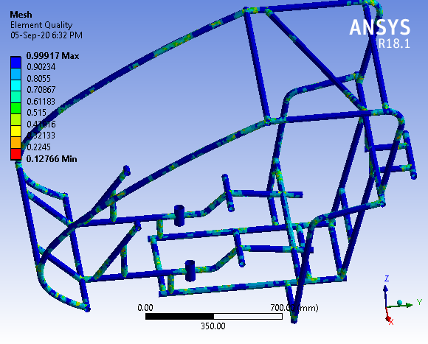
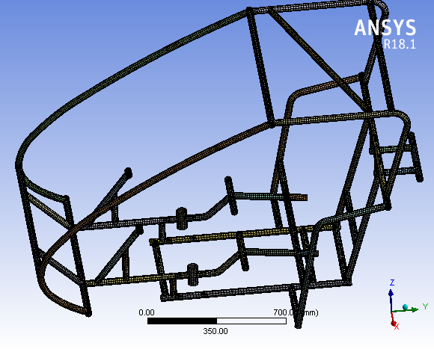
Steel AISI 1018,1.25in x 1.13in x 1.5mm
Page 3.15

Slide 31
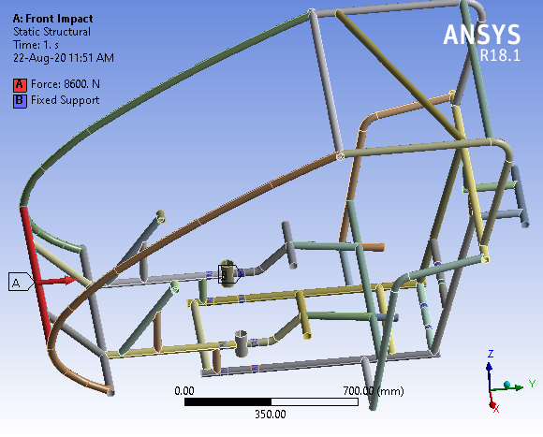
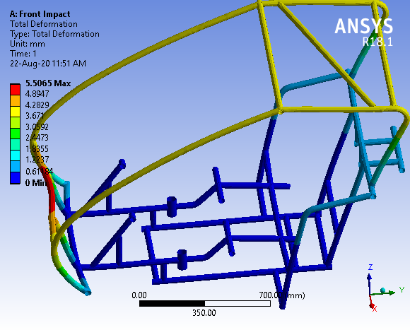
FRONT IMPACT
Page 3.16

Slide 32
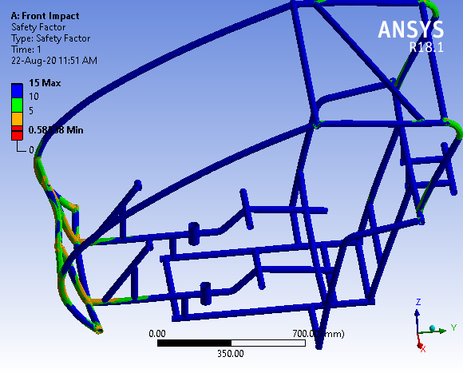
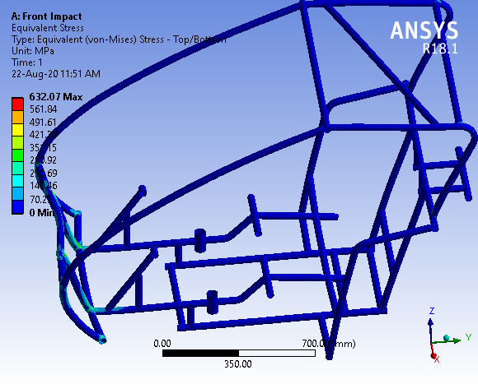
FRONT IMPACT
Page 3.17

Slide 33
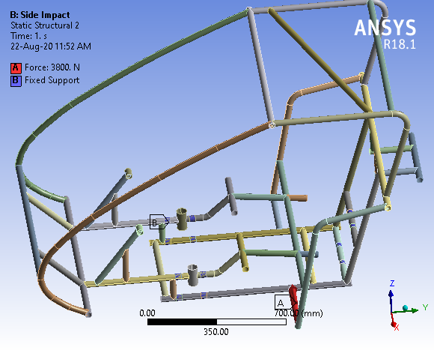
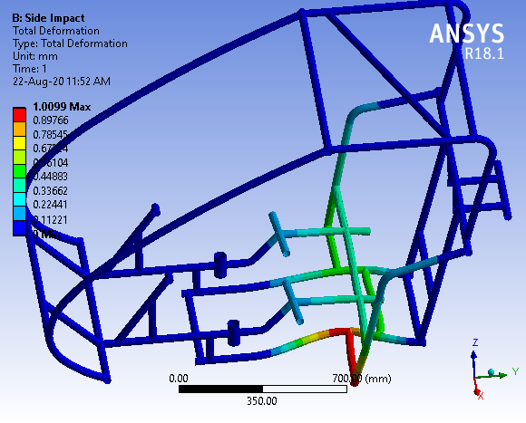
SIDE IMPACT
Page 3.18

Slide 34
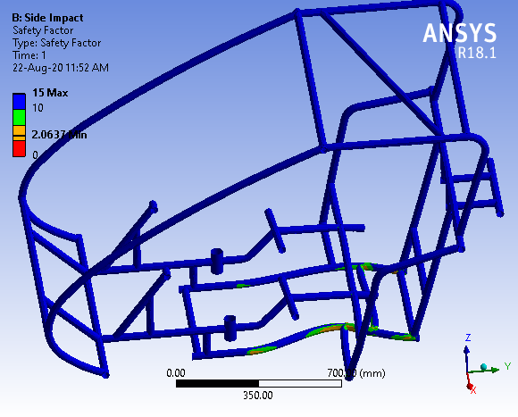
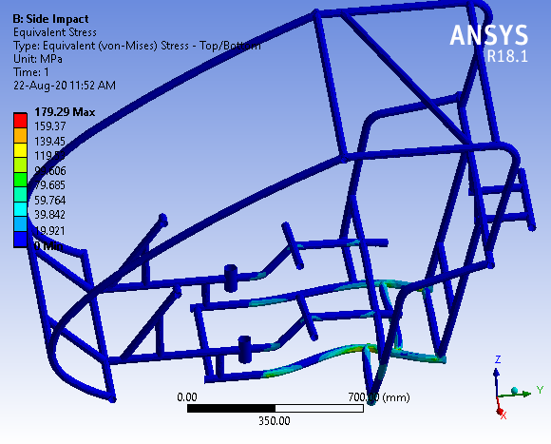
SIDE IMPACT
Page 3.19

Slide 35
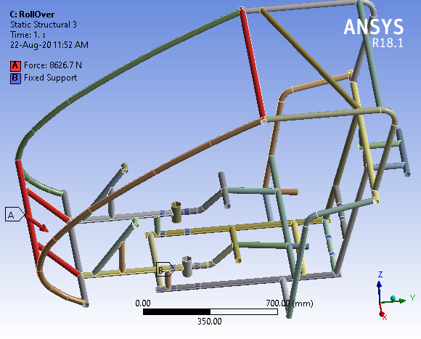
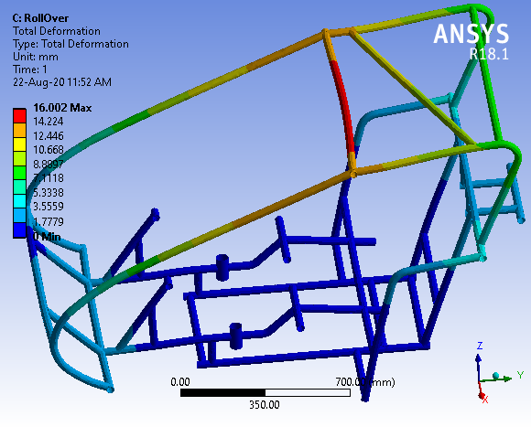
ROLL-OVER IMPACT
Page 3.20

Slide 36
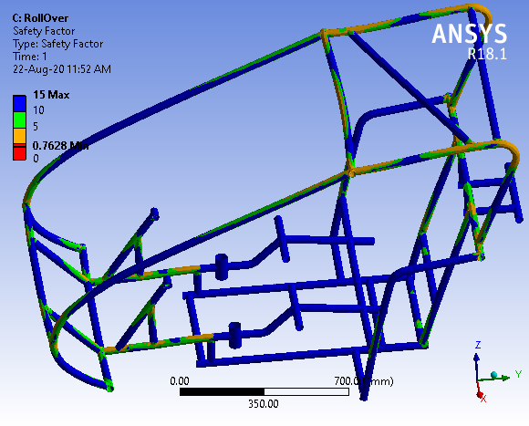
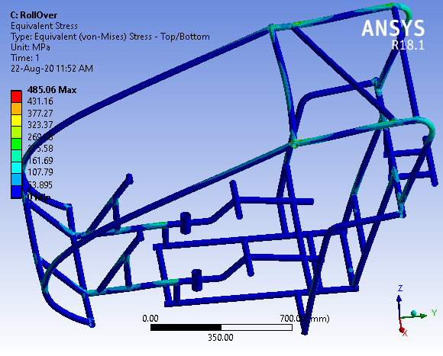
ROLL-OVER IMPACT
Page 3.21

Slide 37
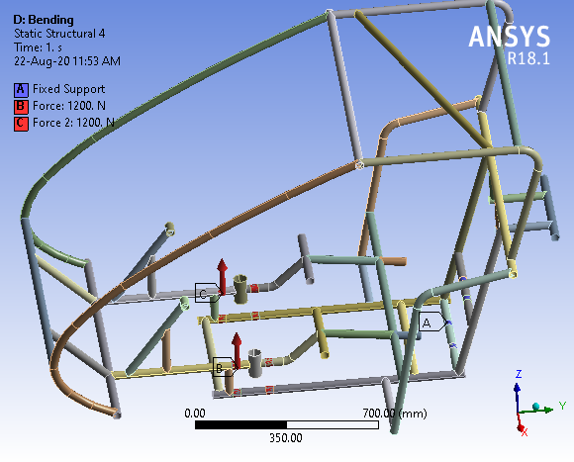
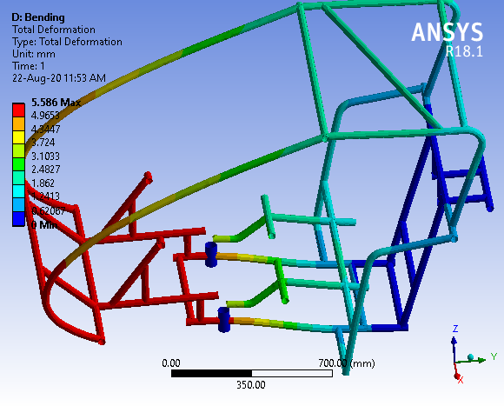
BENDING
Page 3.22

Slide 38
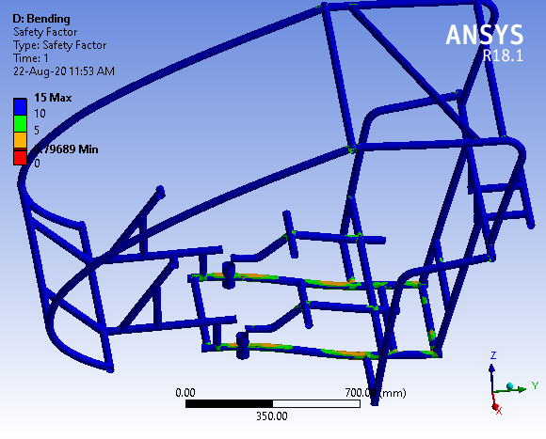
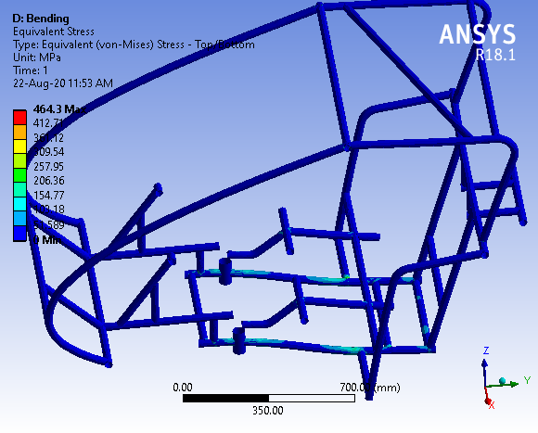
BENDING
Page 3.23

Slide 39


TORSION
Page 3.24

Slide 40


TORSION
Page 3.25

Slide 41

FE modelling and CAE Analysis of Frame
Parameters considered/Change details :0.15-0.20% Carbon, 1.25in diameter and 1.5mm thickness, AISI 1018
(Instructions : Material spec ,cross section, Material Combinations)
Target weight- 30Kg
Design weight- 31.49Kg
Iteration-2
Test Run | Max Stress (MPa) |  | Max Deformation (mm) |  | Min FOS |  | Acceptability
 | Actual | Target | Actual | Target | Actual | Target | Yes/No
Frontal | 632.07 | 400 | 5.50 | 3 | 0.58 | 1 | No
Side | 179.29 | 200 | 1.00 | 1 | 2.06 | 2 | Yes
Rollover | 485.06 | 400 | 16.00 | 10 | 0.76 | 1 | No
Torsion | 154.89 | 200 | 2.04 | 2 | 2.38 | 3 | Yes
Bending | 464.3 | 400 | 5.58 | 3 | 0.79 | 1 | No
Justification of Accepting/ Rejecting Design: It is rejected because the factor of safety was less and the strength of material was less.
Page 3.26

Slide 42
FE modelling and CAE Analysis of Frame
Include image of FE models for iteration-3.
Include FE model of different load cases (front, side, rollover etc) in separate slides.
For each load cases following pictures to be included:
Pre-processing: Meshed View, Load Distribution, Boundary Conditions
Post-processing: view after simulation showing stress, strain, deformation and FOS.
Page 3.27

Slide 43



Steel AISI 4130,1.25in x 1.13in x 1.5mm
Page 3.28

Slide 44


FRONT IMPACT
Page 3.29

Slide 45


FRONT IMPACT
Page 3.30

Slide 46


SIDE IMPACT
Page 3.31

Slide 47


SIDE IMPACT
Page 3.32

Slide 48


ROLL-OVER IMPACT
Page 3.33

Slide 49


ROLL-OVER IMPACT
Page 3.34

Slide 50


BENDING
Page 3.35

Slide 51


BENDING
Page 3.36

Slide 52


TORSION
Page 3.37

Slide 53


TORSION
Page 3.38

Slide 54

FE modelling and CAE Analysis of Frame
Parameters considered/Change details :0.28-0.33% Carbon, 1.25in Diameter and 1.5mm thickness, AISI 4130
(Instructions : Material spec ,cross section, Material Combinations)
Target weight- 30Kg
Design weight- 31.41Kg
Iteration-3
Test Run | Max Stress (MPa) |  | Max Deformation (mm) |  | Min FOS |  | Acceptability
 | Actual | Target | Actual | Target | Actual | Target | Yes/No
Frontal | 632.07 | 400 | 5.50 | 3 | 0.72 | 1 | No
Side | 179.29 | 200 | 1.00 | 1 | 2.56 | 2 | Yes
Rollover | 485.06 | 400 | 16.00 | 10 | 0.94 | 1 | No
Torsion | 154.89 | 200 | 2.04 | 2 | 2.96 | 3 | Yes
Bending | 464.3 | 400 | 5.58 | 3 | 0.99 | 1 | No
Justification of Accepting/ Rejecting Design: Although the strength of the material is more than AISI 1018 and density is slightly less but upon analysis the factor of safety came less therefore it was rejected.
Page 3.39

Slide 55
FE modelling and CAE Analysis of Frame
Include image of FE models for iteration-4.
Include FE model of different load cases (front, side, rollover etc) in separate slides.
For each load cases following pictures to be included:
Pre-processing: Meshed View, Load Distribution, Boundary Conditions
Post-processing: view after simulation showing stress, strain, deformation and FOS.
Page 3.40

Slide 56



Steel AISI 4130,1.25in x 1.12in x 1.65mm
Page 3.41

Slide 57


FRONT IMPACT
Page 3.42

Slide 58


FRONT IMPACT
Page 3.43

Slide 59


SIDE IMPACT
Page 3.44

Slide 60


SIDE IMPACT
Page 3.45

Slide 61


ROLL-OVER IMPACT
Page 3.46

Slide 62


ROLL-OVER IMPACT
Page 3.47

Slide 63


BENDING
Page 3.48

Slide 64


BENDING
Page 3.49

Slide 65


TORSION
Page 3.50

Slide 66


TORSION
Page 3.51

Slide 67

FE modelling and CAE Analysis of Frame
Parameters considered/Change details :0.28-0.33% Carbon, 1.25in Diameter and 1.65mm thickness, AISI 4130
(Instructions : Material spec ,cross section, Material Combinations)
Target weight- 30Kg
Design weight- 34.32Kg
Iteration-4
Test Run | Max Stress (MPa) |  | Max Deformation (mm) |  | Min FOS |  | Acceptability
 | Actual | Target | Actual | Target | Actual | Target | Yes/No
Frontal | 564.93 | 400 | 4.95 | 3 | 0.81 | 1 | No
Side | 164.76 | 200 | 0.92 | 1 | 2.79 | 2 | Yes
Rollover | 433.48 | 400 | 14.47 | 10 | 1.06 | 1 | Yes
Torsion | 137.28 | 200 | 1.85 | 2 | 3.35 | 3 | Yes
Bending | 424.26 | 400 | 5.21 | 3 | 1.08 | 1 | Yes
Justification of Accepting/ Rejecting Design: It was selected because all the criteria were satisfied and the weight of chassis was not very high.
Page 3.52

Slide 68
FE modelling and CAE Analysis of Hard Points
Include image of FE models for different iterations for location-1.
For each iteration following pictures to be included:
Pre-processing: Meshed View, Load Distribution, Boundary Conditions
Post-processing: view after simulation showing stress, strain, deformation and FOS.
Page 4.1

Slide 69


Steel AISI 1018,1in x 0.84in x 2mm
Page 4.2

Slide 70


SUSPENSION MOUNTING
Page 4.3

Slide 71


SUSPENSION MOUNTING
Page 4.4

Slide 72

SUSPENSION MOUNTING
Page 4.5

Slide 73


Steel AISI 1018,1.25in x 1.13in x 1.5mm
Page 4.6

Slide 74


SUSPENSION MOUNTING
Page 4.7

Slide 75


SUSPENSION MOUNTING
Page 4.8

Slide 76

SUSPENSION MOUNTING
Page 4.9

Slide 77


Steel AISI 4130,1.25in x 1.13in x 1.5mm
Page 4.10

Slide 78


SUSPENSION MOUNTING
Page 4.11

Slide 79


SUSPENSION MOUNTING
Page 4.12

Slide 80

SUSPENSION MOUNTING
Page 4.13

Slide 81


Steel AISI 4130,1.25in x 1.12in x 1.65mm
Page 4.14

Slide 82


SUSPENSION MOUNTING
Page 4.15

Slide 83


SUSPENSION MOUNTING
Page 4.16

Slide 84

SUSPENSION MOUNTING
Page 4.17

Slide 85




FE modelling and CAE Analysis of Hard Points
Location-1: Suspension Mounting
model
model
model
model
Steel AISI 1018,1inx0.84inx2mm
Steel AISI 1018,1.25inx1.13inx1.5mm
Steel AISI 4130,1.25inx1.13inx1.5mm
Steel AISI 4130,1.25inx1.12inx1.65mm
Iterations | Max Stress (Target) | Max Deformation(Target) | Min FOS(Target) | Acceptability (Yes/No)
1 | 194.5 | 2.18 | 1.90 | Yes
2 | 95.97 | 1.72 | 3.85 | Yes
3 | 95.97 | 1.72 | 2.60 | Yes
4 | 88.15 | 1.55 | 2.83 | Yes
Justification :All the materials are eligible for this criteria but last one was selected based upon other analysis and criterias.
Page 4.18

Slide 86
FE modelling and CAE Analysis of Hard Points
Include image of FE models for different iterations for location-2.
For each iteration following pictures to be included:
Pre-processing: Meshed View, Load Distribution, Boundary Conditions
Post-processing: view after simulation showing stress, strain, deformation and FOS.
Page 4.19

Slide 87
Steel AISI 1018,1in x 0.84in x 2mm
Page 4.20

Slide 88
SUSPENSION MOUNTING
Page 4.21

Slide 89
SUSPENSION MOUNTING
Page 4.22

Slide 90
SUSPENSION MOUNTING
Page 4.23

Slide 91
Steel AISI 1018,1.25in x 1.13in x 1.5mm
Page 4.24

Slide 92


SEAT MOUNTING
Page 4.25

Slide 93


SEAT MOUNTING
Page 4.26

Slide 94

SEAT MOUNTING
Page 4.27

Slide 95
Steel AISI 4130,1.25in x 1.13in x 1.5mm
Page 4.28

Slide 96


SEAT MOUNTING
Page 4.29

Slide 97


SEAT MOUNTING
Page 4.30

Slide 98

SEAT MOUNTING
Page 4.31

Slide 99
Steel AISI 4130,1.25in x 1.12in x 1.65mm
Page 4.32

Slide 100


SEAT MOUNTING
Page 4.33

Slide 101


SEAT MOUNTING
Page 4.34

Slide 102

SEAT MOUNTING
Page 4.35

Slide 103
FE modelling and CAE Analysis of Hard Points
Location-2: Seat Mounting
Iteration-1
Design Picture
Iteration-2
Design Picture
Iteration-3
Design Picture
Iteration-4
Design Picture
Steel AISI 1018,1inx0.84inx2mm
Steel AISI 1018,1.25inx1.13inx1.5mm
Steel AISI 4130,1.25inx1.13inx1.5mm
Steel AISI 4130,1.25inx1.12inx1.65mm
Iterations | Max Stress (Target) | Max Deformation(Target) | Min FOS(Target) | Acceptability (Yes/No)
1 | 107 | 0.75 | 3.45 | Yes
2 | 100.26 | 0.92 | 3.69 | Yes
3 | 100.26 | 0.92 | 2.49 | Yes
4 | 91.00 | 0.83 | 2.74 | Yes
Justification :The factor of safety is more than one for each material thus each one them is acceptable.
Page 4.36

Slide 104
FE modelling and CAE Analysis of Hard Points
Include image of FE models for different iterations for location-3.
For each iteration following pictures to be included:
Pre-processing: Meshed View, Load Distribution, Boundary Conditions
Post-processing: view after simulation showing stress, strain, deformation and FOS.
Page 4.37

Slide 105
Steel AISI 1018,1in x 0.84in x 2mm
Page 4.38

Slide 106


BATTERY MOUNTING
Page 4.39

Slide 107


BATTERY MOUNTING
Page 4.40

Slide 108

BATTERY MOUNTING
Page 4.41

Slide 109
Steel AISI 1018,1.25in x 1.13in x 1.5mm
Page 4.42

Slide 110


BATTERY MOUNTING
Page 4.43

Slide 111


BATTERY MOUNTING
Page 4.44

Slide 112

BATTERY MOUNTING
Page 4.45

Slide 113
Steel AISI 4130,1.25in x 1.13in x 1.5mm
Page 4.46

Slide 114


BATTERY MOUNTING
Page 4.47

Slide 115


BATTERY MOUNTING
Page 4.48

Slide 116

BATTERY MOUNTING
Page 4.49

Slide 117
Steel AISI 4130,1.25in x 1.12in x 1.65mm
Page 4.50

Slide 118


BATTERY MOUNTING
Page 4.51

Slide 119


BATTERY MOUNTING
Page 4.52

Slide 120

BATTERY MOUNTING
Page 4.53

Slide 121
FE modelling and CAE Analysis of Hard Points
Location-3: Battery Mounting
Iteration-1
Design Picture
Iteration-2
Design Picture
Iteration-3
Design Picture
Iteration-4
Design Picture
Steel AISI 1018,1inx0.84inx2mm
Steel AISI 1018,1.25inx1.13inx1.5mm
Steel AISI 4130,1.25inx1.13inx1.5mm
Steel AISI 4130,1.25inx1.12inx1.65mm
Iterations | Max Stress (Target) | Max Deformation(Target) | Min FOS(Target) | Acceptability (Yes/No)
1 | 18.18 | 0.38 | 15 | Yes
2 | 6.79 | 0.03 | 15 | Yes
3 | 6.79 | 0.03 | 15 | Yes
4 | 6.11 | 0.02 | 15 | Yes
Justification : The weight of battery is not very high therefore no material undergoes a high stress thus each one them are acceptable.
Page 4.54

Slide 122
FE modelling and CAE Analysis of Hard Points
Include image of FE models for different iterations for location-4.
For each iteration following pictures to be included:
Pre-processing: Meshed View, Load Distribution, Boundary Conditions
Post-processing: view after simulation showing stress, strain, deformation and FOS.
Page 4.55

Slide 123
Steel AISI 1018,1in x 0.84in x 2mm
Page 4.56

Slide 124


SOLAR PANEL MOUNTING
Page 4.57

Slide 125


SOLAR PANEL MOUNTING
Page 4.58

Slide 126

SOLAR PANEL MOUNTING
Page 4.59

Slide 127
Steel AISI 1018,1.25in x 1.13in x 1.5mm
Page 4.60

Slide 128


SOLAR PANEL MOUNTING
Page 4.61

Slide 129


SOLAR PANEL MOUNTING
Page 4.62

Slide 130

SOLAR PANEL MOUNTING
Page 4.63

Slide 131
Steel AISI 4130,1.25in x 1.13in x 1.5mm
Page 4.64

Slide 132


SOLAR PANEL MOUNTING
Page 4.65

Slide 133


SOLAR PANEL MOUNTING
Page 4.66

Slide 134

SOLAR PANEL MOUNTING
Page 4.67

Slide 135
Steel AISI 4130,1.25in x 1.12in x 1.65mm
Page 4.68

Slide 136


SOLAR PANEL MOUNTING
Page 4.69

Slide 137


SOLAR PANEL MOUNTING
Page 4.70

Slide 138

SOLAR PANEL MOUNTING
Page 4.71

Slide 139
FE modelling and CAE Analysis of Hard Points
Location-4: Solar Panel Mounting
Iteration-1
Design Picture
Iteration-2
Design Picture
Iteration-3
Design Picture
Iteration-4
Design Picture
Steel AISI 1018,1inx0.84inx2mm
Steel AISI 1018,1.25inx1.13inx1.5mm
Steel AISI 4130,1.25inx1.13inx1.5mm
Steel AISI 4130,1.25inx1.12inx1.65mm
Iterations | Max Stress (Target) | Max Deformation(Target) | Min FOS(Target) | Acceptability (Yes/No)
1 | 10.69 | 0.22 | 15 | Yes
2 | 7.79 | 0.18 | 15 | Yes
3 | 7.79 | 0.18 | 15 | Yes
4 | 6.84 | 0.16 | 15 | Yes
Justification : Each material have a factor of safety equal to 15 thus each one of them are acceptable.
Page 4.72

Slide 140
Result Comparison and Optimization Details
Summarize the comparison of results achieved in different iterations.
Mention what optimizations were included in different iterations and how the final design was achieved.
Provide picture of final design (CAD view) and details of material(s).
Overall Summary
Page 5.1

Slide 141
Result Comparison
By analysis the most suitable material to handle all the impacts is AISI 4130 1.25in x 1.12in x 1.65mm.
Page 5.2

Slide 142
Optimization
Unnecessary members were removed from the design to reduce the weight of chassis.
T joints were preferred instead of corner joints to increase the strength of joints.
Page 5.3

Slide 143


CAD DESIGN
Page 5.4

Slide 144
Details of Material
Material Used is AISI 4130 1.25in diameter and 1.65 thickness
Bending Strength is 354.46 N/m²
Bending Stiffness is 3.014x10³ Nm²
Density of AISI 4130 stainless steel is 7.85 g/cm³
Weight of Chassis is 34.32Kg
Page 5.5

Slide 145
Overall Summary
As discussed, our approach is to design for the cheap and still optimize so that we avoid overdesigning , this would help us to reduce the cost.
The approach that we followed is iterative in nature and processes like reverse engineering are adopted in order to select various systems from the ones existing in the market. This step would ensure standardization and reliability would follow as a by part.
Our top priority would always be the safety of the driver and working in this direction, we will strive to add aesthetic value and a sense of ergonomics to the vehicle.
Page 5.6

